Slide 1
Fair Trade
Today you will act as buyers and sellers of artworks

Slide 2
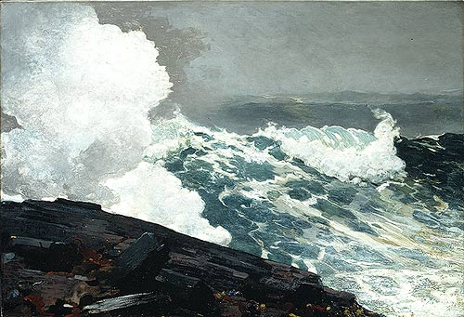
Winslow Homer painted Northeaster in 1895 (115 years ago). He was 56 years old and living by himself in a lighthouse by the sea.

Slide 3
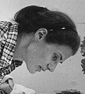
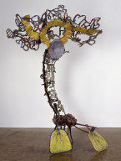
Nancy Graves created this sculpture in 1983 (27 years ago). She was 44 years old. She loved science, nature and the sky.

Slide 4
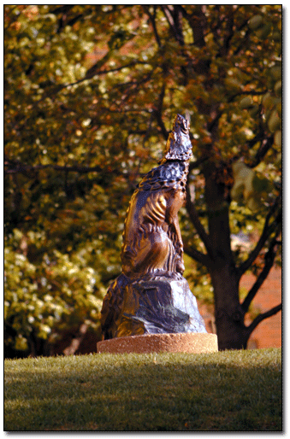
Luis Jiménez created the sculpture Howl in 1986 (24 years ago). He was 46. He died in 2006 when one of his sculptures fell on his leg and cut an artery. His daughter Elisa participated in Project Runway.

Slide 5
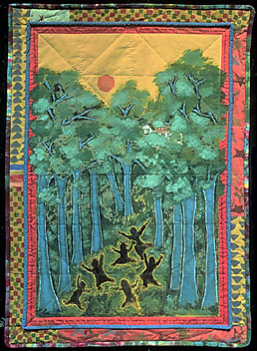
Faith Ringgold made the painting Only the Children in 2000 (10 years ago). She was 70 years old and she will be 80 on October 8th, 2010. She likes to tell the tales of black people and events from slavery in America.

Slide 6
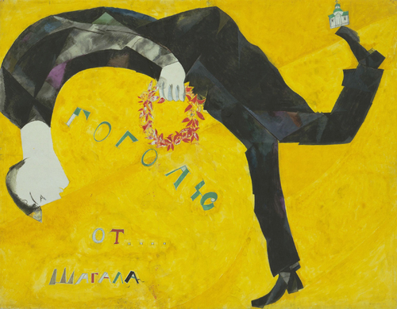
Marc Chagall painted Gogol in 1917 (93 years ago). He was 30 years old. This painting is a portrait of a Russian writer named Gogol.

Slide 7
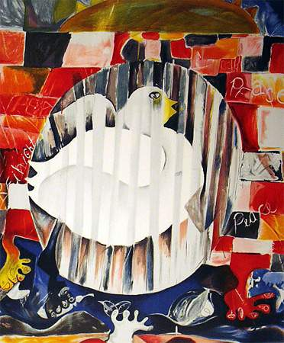
Alexandra Nechita made the print Earth is a Planet with One Piece Missing in 1998 (12 years ago). She was 13 years old. She will be 25 years old this year.

